Slide 1
Writing decoupled and testable code

Slide 2
Who am I?
Lode Kennes
1 year @Axxes
.NET Developer
Projects at SWF, OTN Systems
GreenR
Self employed (secondary activity)
Ask me anything!

Slide 3
Who are you?
Focus on?
Familiar with .NET landscape?
Experienced with IOC?

Slide 4
Practical
Questions just ask them
Part 1: 8.30-12.30
Part 2: 13:30-17.00
Break in between just ask for it
Demo's and slides can be found on Gitlab
Demo's are prepared on
Visual Studio 2019
Dotnet core 2.2

Slide 5
SOLID
Dependency inversion principle
High level modules should not depend on low level modules
Modules should depend on abstractions
Notes:
Low level modules should depend on high level modules -> inversion
Important dependency inversion is the principle "the way it should work"
Dependency injection is a way to make it work

Slide 6
Agenda for today
Dependencies and coupling
DI principles + ioc containers
Service locators
Other techniques for object creation
Architectural styles built around dependencies

Slide 7
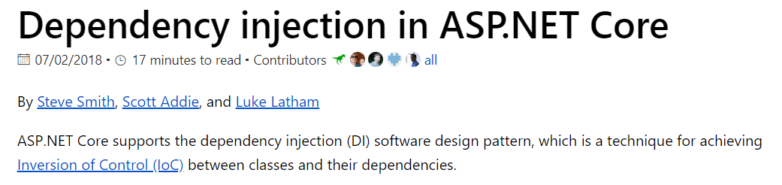
Asp net core
Notes:
Dependency inversion/Inversion of control is not hard

Slide 8
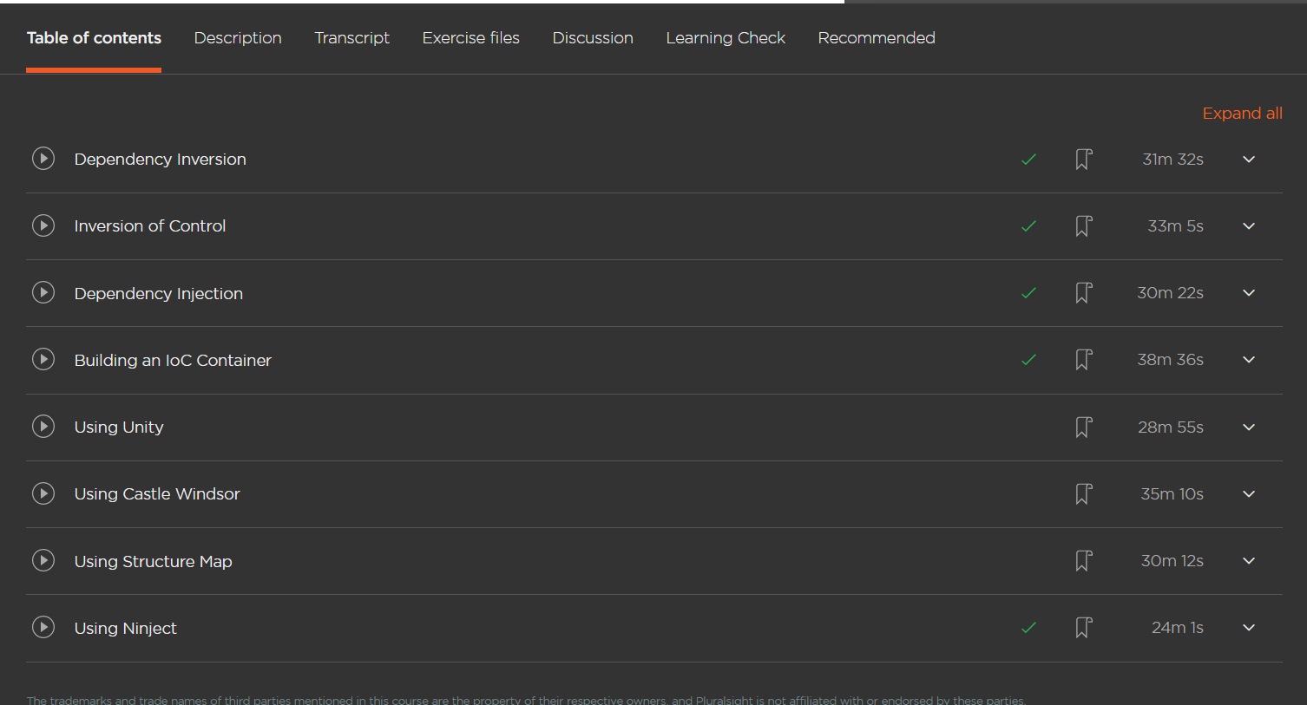
Pluralsight

Slide 9
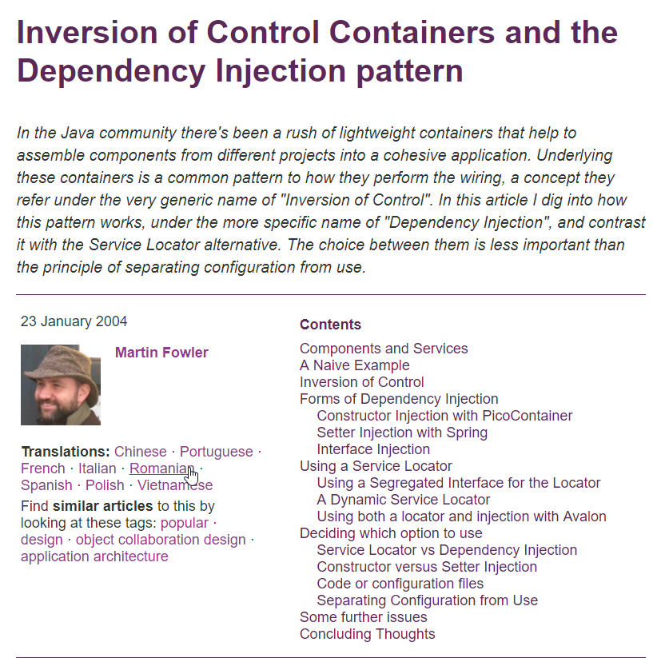
Martin Fowler’s article on IOC
https://www.martinfowler.com/articles/injection.html
Notes:
It's not new

Slide 10
Inversion of control can’t be hard

Slide 11
Why is coupling bad
What does it mean?
Class/components depending on other classes and components
Limits functionality to a single known implementation
You cannot swap the implementation without breaking the code
Code is not testable
During a unit test you want to test a piece of the component not the whole flow -> integration
Agile practices are hard to accomplish
Working with multiple team member on the same feature is hard
It’s bad for your reputation as a developer ☺

Slide 12
Embrace abstractions
The secret to writing decoupled/testable software:
Write against abstractions instead of concrete implementations
Stop newing up classes
Note: not talking about models or dto’s
New is glue
Previous years this was shocking.
How do you want to create instances?
Well there are other ways of doing this

Slide 13
Embrace abstractions
Define dependencies as interfaces
Remember the definition of an interface:
A public contract where the consumer talks to the interface and does not now the actual implementation​

Slide 14
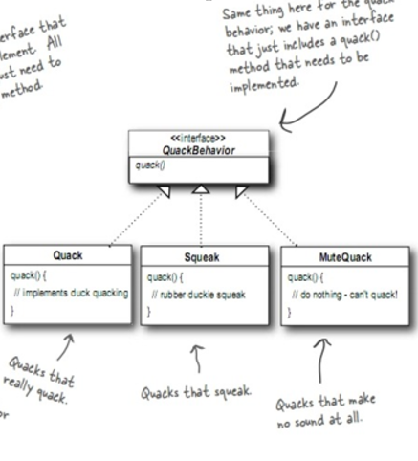
Remember this

Slide 15
Embrace abstractions
This is how most educational programs used to learn students about interfaces
Only from a polymorphic point of view
Making classes implement interfaces is there a cost?
In the old days of OO not every class was an interface​ because working with an interface was slower​

Slide 16
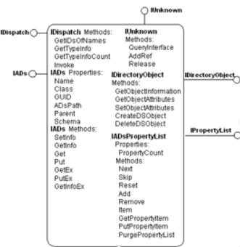
Embrace abstractions

Slide 17
Embrace abstractions
Component Object Model
1993
Microsoft
Wikipedia explanation:
De werking van COM-objecten is vergelijkbaar met die van objecten in een object-georiënteerde programmeertaal. Een COM-object bevat een interface, waarin gedefinieerd is welke hoofdfunctionaliteiten het COM-object heeft. Het gebruiken van het COM-object door andere objecten verloopt dan ook via de functies in de COM-interface. De interne werking van het COM-object blijft verborgen voor gebruikers. Omdat de werking en het gebruik van COM-objecten zoveel lijkt op de manier van programmeren in een OO-taal, zijn COM-objecten ook goed te gebruiken in een dergelijke omgeving.

Slide 18
Demo DI.Coupled, DI.Abstraction, DI.UnitTests

Slide 19
Object creation (IOC)
Invert the creation of objects​
“Creation Inversion”​
Create objects outside of the class they are being used​
Factory pattern​
Service locator​
Dependency injection​
2 flavors: pull or push mechanisms

Slide 20
DI container
A repository for definitions typically relating an abstraction to a concrete class
Think of it as a bucket
Core functionality
Provide facility to register classes related to an interface
Provide facility for resolving a request from a given interface
So it’s about registration and resolving
Push mechanism

Slide 21
DI container
Registrations or type associations can be achieved in different ways depending on the container you are using
Procedural (fluent interface)
Unity, Ninject, Castle Windsor, StructureMap, Autofac
Configuration
Spring.net, Autofac
Declarative (with attributes)
MEF
Registrations only needs to be done once. Mostly done in some kind of bootstrapper.

Slide 22
DI container
Resolving process
Recursively resolving dependencies
Requesting one class from the container starts a chain reaction
Different mechanisms​
Constructor injection​ (most common)
Properties injection​
Interface injection​ (never used this)
Method injection (most frameworks don’t support this)​

Slide 23
Demo DI.PoorMansContainer

Slide 24
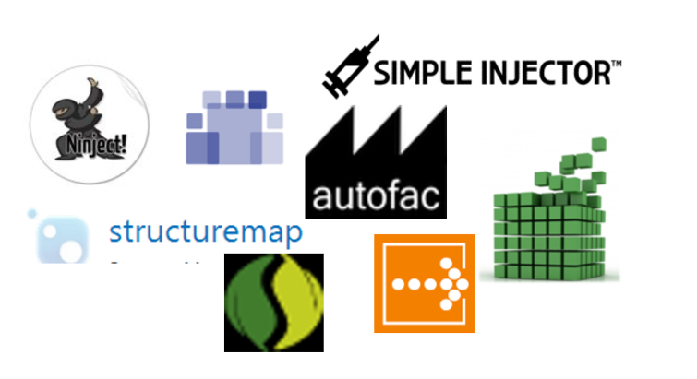
DI container
Different flavor’s

Slide 25
Ninject
Open source Ioc container ​
First version in 2007​
Simple​
Extensible​
Good community -> a lot of nuget packages​
Works with a kernel instead of a container

Slide 26
Unity
IoC container from Microsoft​
Delivered by the patterns and practices team​
Part of the Entreprise Library​
Can be downloaded together with the Entreprise Library or as a Nuget package​
Is extensible

Slide 27
Castle Windsor
Open source IoC container​
Part of the Castle project​
Set of tools for .NET and Xaml​
One of the first IoC containers for .NET​
Creator also worked on MEF as a program manager at Microsoft

Slide 28
Autofac
Open-source IoC container originally developed on Google Code​
Was the first to also windows phone and windows store apps​
Works with a Builder constructed with lambda’s​. The container is created by the builder.
Gaining a lot of popularity over the last years​
Allows injection via xml configuration -> change wiring without recompiling

Slide 29
Demo DI.Autofac, DI.CastleWindsor, DI.Ninject, DI.StructureMap, DI.Unity

Slide 30
Which container
Size and licensing
Framework | License | Minimum required dlls | Size(kB)
Castle | Apache 2 | 2 | 192
Unity | MS PL | 2 | 120
Ninject | Apache 2 | 1 | 147
Autofac | MIT | 1 | 110
Structuremap | Apache 2 | 1 | 164
Spring.NET | Apache 2 | 3 | 728

Slide 31
Which container
Registration/configuration flavor
Framework | Fluent | Automatic registration | Xml usage
Castle | yes | yes | Supported but not required
Unity | yes | yes | Supported not required
Ninject | yes | yes | Possible via Ninject.Extensions package
Autofac | yes | yes | Supported not required
Structuremap | yes | yes | Supported not required
Spring.NET | Method chaining | Not supported | Encouraged approach

Slide 32
Which container
Benchmarks
https://github.com/danielpalme/IocPerformance
Community
Active development
Documentation
Extensions
Reputation of contributors
Just like cryptocurrencies ICO's you will have to dive into the github repo's
Notes:
https://github.com/danielpalme/IocPerformance

Slide 33
Instance lifetime
Transient​
Resolved instance kept until parent goes away​
Default in most containers​
Singleton​
Shared instance​
Resolve request returns the same instance until container goes away​
Be careful with threads​
Scoped
Every http request
Dbcontext of EF you don’t want to share this with other end users

Slide 34
Instance lifetime
How are objects coming from a container disposed?
In a regular program the instance is garbage collected when out of scope
In general the rule is only call Dispose() on object you are the owner
Objects you newed
You can not assume you are the only consumer of the object
IoC containers don’t know when dispose was called on an instance​
When the container is disposed the instances get disposed​
Or you can tell the container when to dispose by defining a scope if it is supported by the container
Notes:
https://autofaccn.readthedocs.io/en/latest/lifetime/instance-scope.html

Slide 35
Demo instance lifetime

Slide 36
Autowiring dependencies
Setting up registrations in big applications is a lot of work
Sometimes you want to work based on conventions
More dynamic
Accomplished via assembly scanning

Slide 37
Demo Autowiring, Vision event handlers

Slide 38
Modules
When your application grows the bootstrap code for DI also grows
How to organize these registrations?
A module is a small class that can be used to bundle up a set of related components behind a ‘facade’ to simplify configuration and deployment.
Modules do not use dependency injection themselves
Most containers use modules for
Packing similar services together
Optional application futures (Plugin style)
Environment specific registrations
http://autofaccn.readthedocs.io/en/latest/configuration/modules.html

Slide 39
Demo modules

Slide 40
Multiple constructors
What with multiple constructors​?
Different strategies depending on the container
The first constructor they find in code​
The constructor with a metadata attribute​
What I don’t like here is scattering the DI containers code around in your code​
The constructor with the most parameters ​ -> greedy

Slide 41
Demo constructor finder

Slide 42
Post-construction resolve
Kicks off resolve process AFTER the class has been instantiated​
Useful when your class is created at a certain moment in time by something else​
Wcf servicehost or Service Fabric
Remember this will have to use property injection​ since the resolve process kicks off after the class is instantiated, constructor injection is not possible

Slide 43
Demo post-construction resolve

Slide 44
Demo with multiple implementations

Slide 45
Platform specific
Notes:
What about frameworks like asp.net they already use dependency injection and have hooks you can use

Slide 46
WPF
Used to resolve ViewModel classes
Used to resolve dependencies injected into ViewModels
Used to resolve nested ViewModels
ViewModels can be tested and test dependency implementations used
Registrations in the App class
Resolved in the MainWindow class

Slide 47
Demo WPF

Slide 48
ASP NET MVC
Used to resolve controller classes
Used to resolve injected dependencies into controllers
Can use a custom controller factory or dependency resolver (recommended)
Controllers can be tested and test dependency implementations used
Most DI containers have specific NuGet integration package for each MVC version

Slide 49
Demo MVC

Slide 50
WCF
Different injection strategies
Custom ServiceHostFactory which creates the ServiceHost
Service Behavior
Most DI containers have NuGet integration packages for WCF

Slide 51
Demo WCF

Slide 52


Slide 53
ASP NET Core
Out of the box support for DI
Custom basic container implementation
It’s possible to plug an existing DI container into the asp net core framework
Asp net core is open source so all code for DI can be seen here
https://github.com/aspnet/DependencyInjection
https://docs.microsoft.com/en-us/aspnet/core/fundamentals/dependency-injection

Slide 54
Demo Asp net core DI

Slide 55
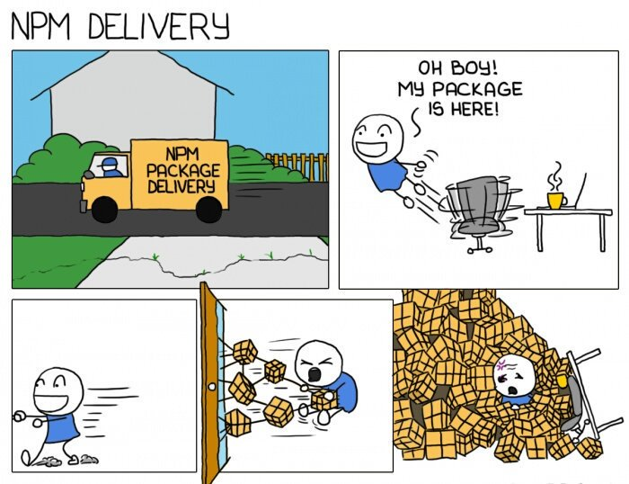

Slide 56
Service locator
Pull mechanism​
Used when a class needs a lot of dependencies (stops constructor parameter explosion)
Can be used instead of post construction resolve
Returns the correct service based on a key​
Wraps a registry which can be a dictionary, an IOC container or something else​
In case DI container is wrapped -> on-demand instances
Biggest disadvantages​
Only one registry -> pay attention with concurrency​
More vulnerable for runtime errors​

Slide 57
Service locator anti-pattern
According to some people service location is an anti-pattern
Originates from Mark Seemann’s book and blogpost
http://blog.ploeh.dk/2010/02/03/ServiceLocatorisanAnti-Pattern/
In short the problem is you may not see the dependencies of a class with a service locator like you see them with a DI container
Causing runtime errors instead of compile time errors
Maintenance hell
In my opinion it depends how you use the locator
https://stackoverflow.com/questions/22795459/is-servicelocator-an-anti-pattern/22795888#22795888

Slide 58
Demo service locator

Slide 59
Factory pattern
Gang of four design pattern​
Uses a pull mechanism​
Mostly done with 2 abstractions​
on the factory itself​
on the instance the factory creates​
Advantage client code must not change​
Disadvantage when we need a new concrete implementation the factory code will need to change​

Slide 60
Demo factory pattern

Slide 61
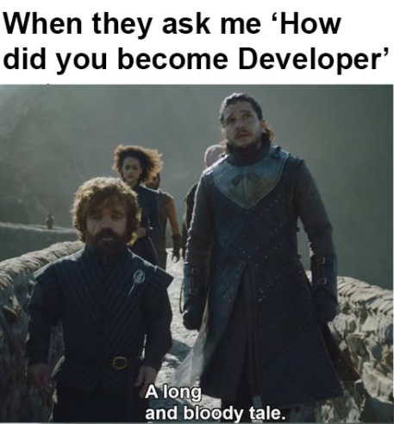


Slide 62
Conclusion
The core principle of testable code is usage of interfaces to build decoupled components
Containers offer different features
For most part, all accomplish the same thing
Choose the one that you like
Inversion of control != DI container
A DI container does NOT facilitate testing
The DI concepts do
Service locator is an anti-pattern -> it depends

Slide 63
The problem

Slide 64
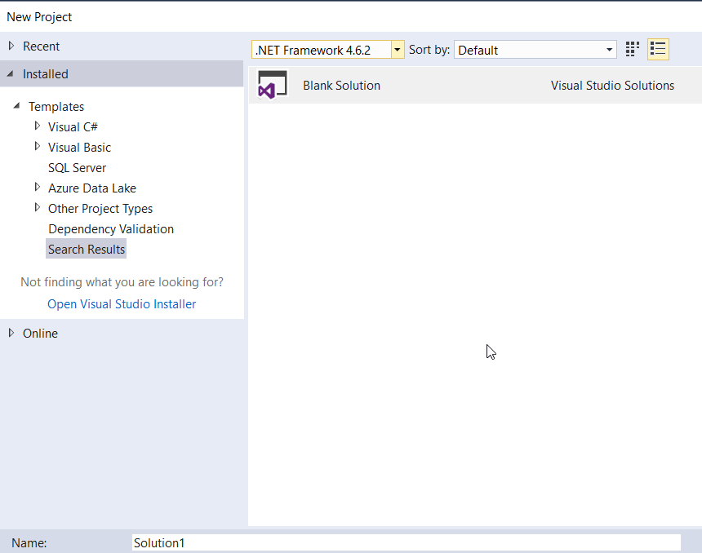

Slide 65
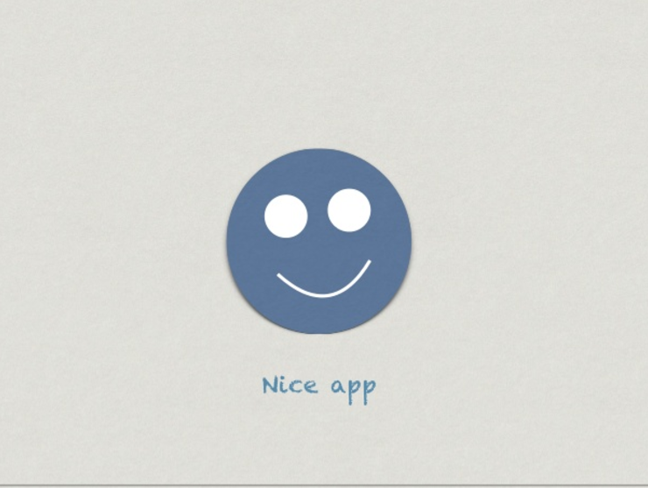
What we want

Slide 66
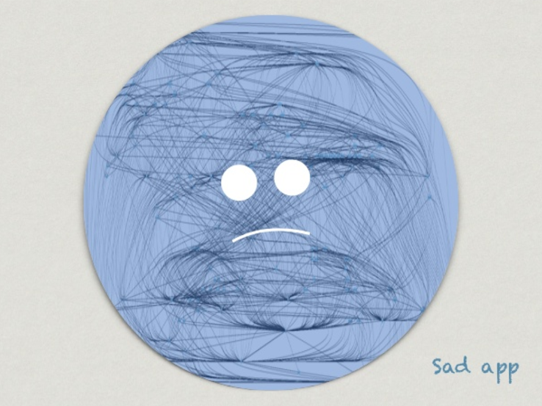
Quickly becomes

Slide 67
Because
Bad abstractions
Wrong cohesion
Which things belong together
2 much developer freedom
Coupling to frameworks and libraries
Utility projects
Frameworks scattered all over the application
Frameworks only help with encapsulation
No guidance
How do you start a new project?

Slide 68
A good solution
Classes that change together should be packaged together​
Deployment deliverables​
Separation of concerns​
Applies to classes and components​
Establish boundaries to seperate behaviours and responsibilities in a system​
Remember a class should only be responsible for only one thing, the same is true for components​

Slide 69
Companies try to solve this in different ways
A written guide​
Publisher is a developer with lot's of experience​
Several custom project templates​
Still to much responsability for the developers​
Code reviews​
Guidance automation​
Best approach​
Problems to get it to work(installation, errors with recipe)​
Developers can still decide to put logic in the UI

Slide 70
Architectural patterns
Not design patterns​
Help to structure your solution and software​
Keep track of dependencies​
Ways of laying out your software/solution​
Help you to make decisions about coupling and cohesion
How are things linked to each other?
Which things belong together?

Slide 71
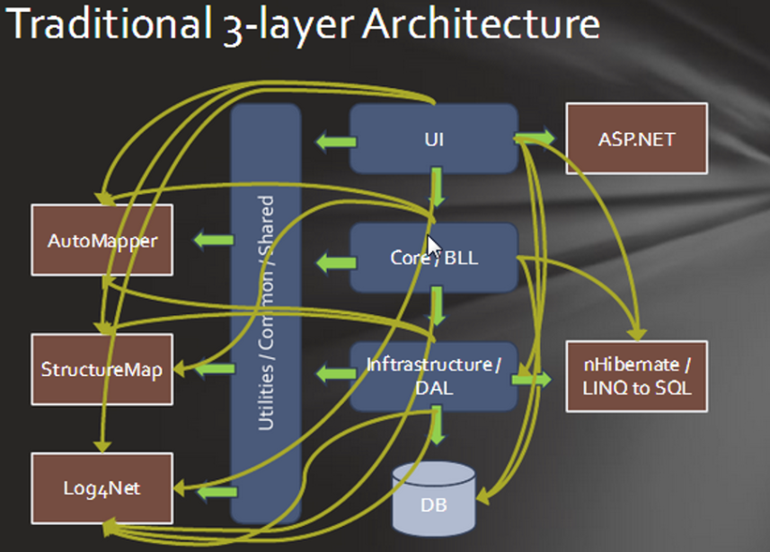
First answer on cohesion and coupling: 3 layered architecture

Slide 72
3 layered architecture
The concept of layers isn’t something new
Think about the OSI model in networking
Every layer is dependend on the layer beneath it
Every layer delegates subtasks to the layer underneath it
At least 3 layers but there is no guidance on the number of layers that should be used
In real life, you can usually count the number of layers within an application by knowing the number of tech leads previously involved on the project
Baklava architecture

Slide 73
3 layered architecture
The business layer depends on the data layer
“The database is an implementation detail”
Easy for developers to put logic in UI​
Easy to pass business logic on purpose or accidentally and perform data access in UI
Devs struggle with finding correct place for code​
Product is built on top of a technology which can change over time(asmx → WCF)​
Logic is scattered, hard to locate code​
Library explosions: easy to add references (log4net, automapper, IOC containers)

Slide 74
Hexagonal architecture
Ports and adapters
There is nothing hexagonal about the hexagonal architecture
Just to represent it visually and it foresees room for drawing ports and adapters
Introduced by Alistair Cockburn in 2000
He was working as a consultant and needed to stop development because a different team first had to write the data access code (integration between smalltalk and rdms)
Prevents the infiltration of the business logic into the UI code
Limits the number of layers
Only inside and outside the hexagon

Slide 75
Hexagonal architecture
Divide the software in 2 distinct regions
Inside the hexagon (the business application logic)
Outside the hexagon (Infrastructure code like database code, web api’s)
Protect the inside with ports and adapters
The port is a description of the dependency, the intention
The adapter is what you code to bridge the domain and the dependency
The adapter belongs in infrastructure
The port belongs in the domain
The port is to go in the hexagon/domain
The adapter is to go out the hexagon/domain
Wiring is done with IOC principles
It’s about configurable dependencies on the left and the right side of the hexagon

Slide 76
Hexagonal architecture
Drivers
A driver could be a script, web api, other applications, user or automated test
The test is the first user of your system
Recipients and repositories
Recipients can be anything that receives notifications from the app
Repositories is the persistence store of the application
Drivers are primary actors
Recipients and repositories are secondary actors
Who starts the communication (trigger) is the primary actor
Primary actor knows the dependency

Slide 77
Hexagonal architecture
Pizza shop example (primary actor)
Imagine you are the hexagon -> responsible for preparing pizza
People can order at the table
People can use the drive in
People can order online
It can be the boss who just want’s to time how long it takes to get a pizza and throw it away
Lot’s of drivers but you are inside the hexagon and the outcome is all the same to you

Slide 78
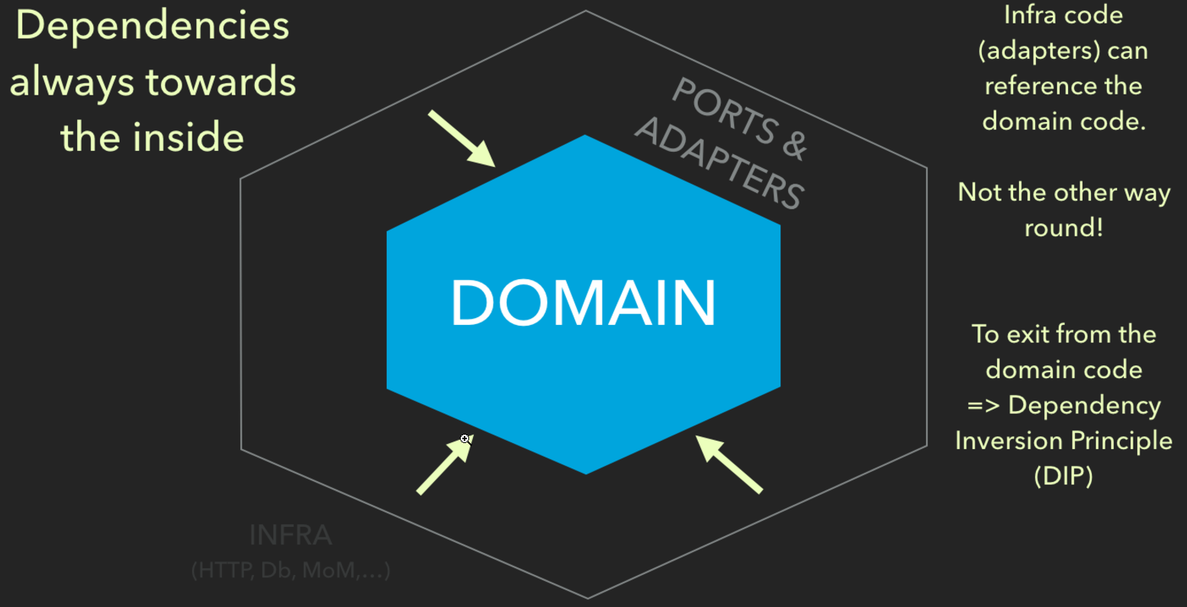

Slide 79
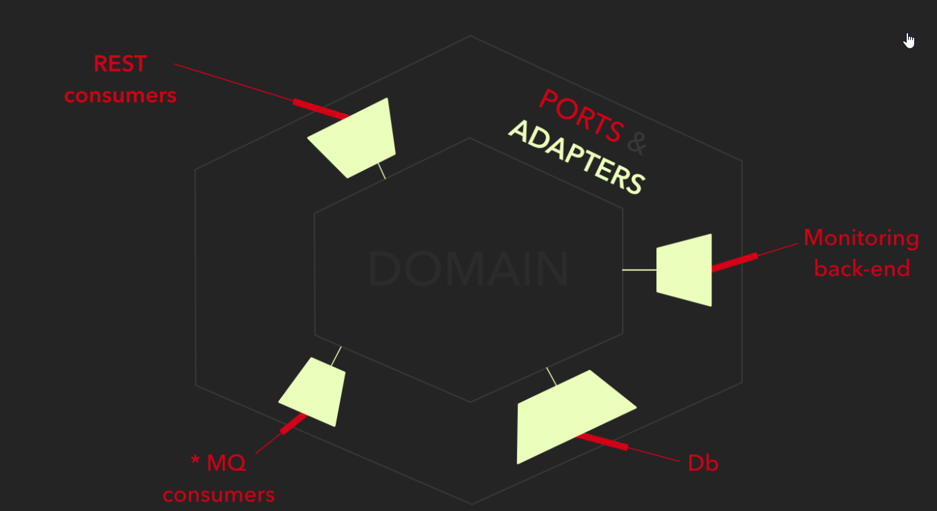

Slide 80
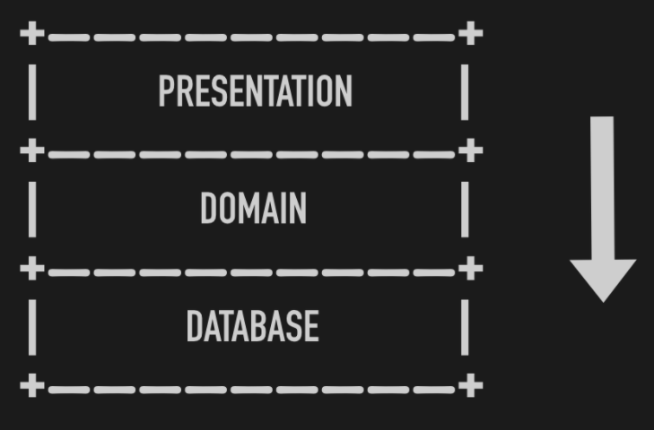

Slide 81
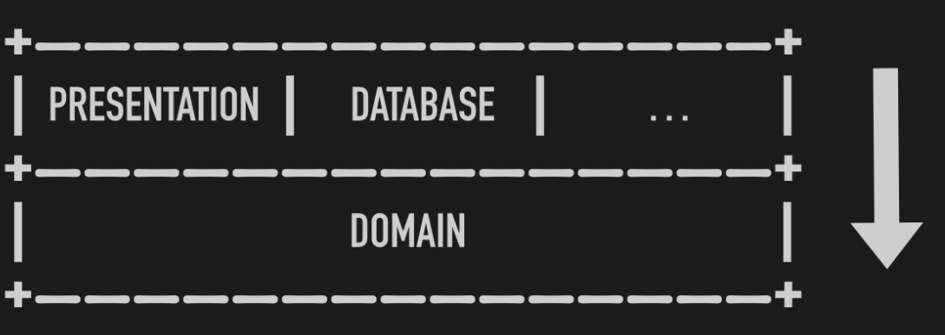

Slide 82
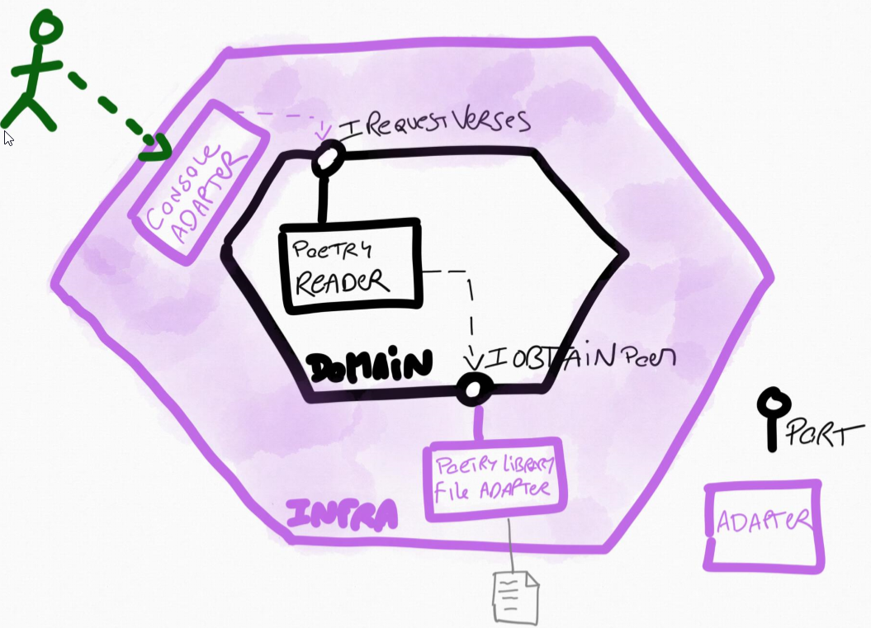

Slide 83
Demo PoetryReader

Slide 84
Onion architecture
First defined in four blogposts by Jeffrey Palermo​
http://jeffreypalermo.com/blog/the-onion-architecture-part-1/
http://jeffreypalermo.com/blog/the-onion-architecture-part-2/
http://jeffreypalermo.com/blog/the-onion-architecture-part-3/
http://jeffreypalermo.com/blog/onion-architecture-part-4-after-four-years/
Very similar to hexagonal architecture
Architectural pattern where the core object model is represented in a way that does not accept dependencies on less stable code
Switch the direction of dependencies

Slide 85
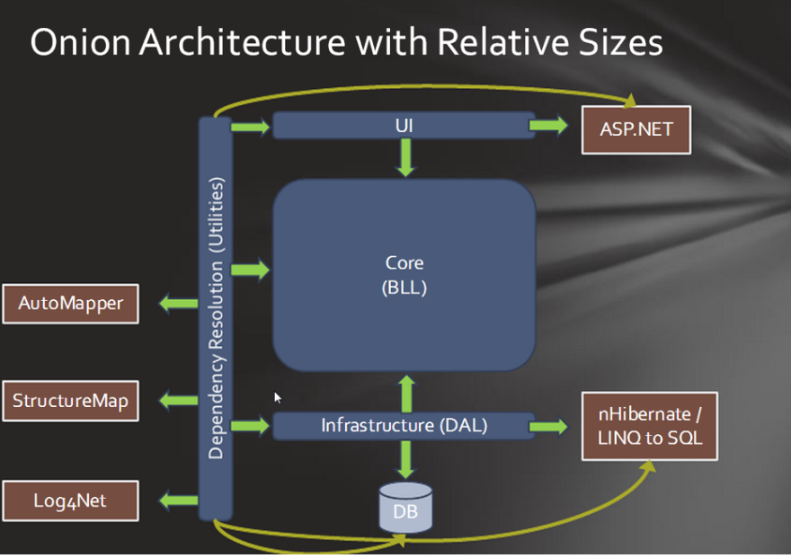

Slide 86
Onion architecture
The application is built around an independent object model​
Inner layers define interfaces. Outer layers implement interfaces​
Direction of coupling is toward the center​
All application core code can be compiled and run seperately from infrastructure. (TDD)

Slide 87
Onion architecture
CORE​
Everything unique to the business: domain models, validation rules, workflows​
Defines all technical implementations as interfaces​
No references to external libraries​
No technology specific code: WCF, MVC, EF​

Slide 88
Onion architecture
INFRASTRUCTURE
Provide implementations to CORE interfaces​
Call web services, acces database, logging​
Can reference external libraries​
Only technology specific code belongs here ​

Slide 89
Onion architecture
DEPENDENCY RESOLUTION
Thin layer, contains no logic​
Wires Core interfaces to Infrastructure implementations​
Runs startup/configuration logic (bootstrapper)

Slide 90
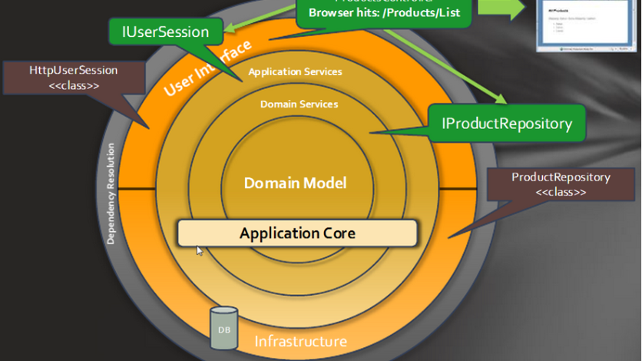

Slide 91
Demo onion architecture

Slide 92
Onion architecture
True loose coupling​
No need for shared utillities projects​
Compiler enforces dependencies boundaries, impossible for core to add reference to infrastructure​
UI and data access become smaller, only technology related stuff in there​
Devs know where to put code (easy model)​
Software is portable not dependent on technology​

Slide 93
Conclusion
Think about the structure of you solution, this impacts your deployments and maintenance
Don’t use too many layers
Don’t couple to a delivery mechanism like the web or an implementation detail like a database
Protect your domain, this is the important stuff
Make the UI, database and other infrastructure a plugin to your application

Slide 94
Learning journey
https://www.youtube.com/user/IAmTimCorey/videos (IAmTimCore)
https://www.pluralsight.com/courses/inversion-of-control (PluralSight)
https://docs.microsoft.com/en-us/aspnet/core/fundamentals/dependency-injection
https://channel9.msdn.com/Shows/Visual-Studio-Toolbox/Dependency-Injection (Channel 9)
https://sourcemaking.com/design_patterns/creational_patterns
https://www.youtube.com/watch?v=th4AgBcrEHA (Alistair Cockburn about hexagonal architecture)
https://dzone.com/articles/hexagonal-architecture-is-powerful (Dzone)
https://jeffreypalermo.com/2008/07/the-onion-architecture-part-1/ (Jeffrey Palermo)
https://youtu.be/IAcxetnsiCQ (Ian Cooper about Onion and Ports and adapters in .NET core)

